Slide 1
Problem Setter Guide
SRIN Pro Academy
Algorithm

Slide 2
Purpose
To generate good Pro-Level problems
To generate original Pro-Level problems
To improve your chance at Pro/Expert level by becoming a thorough Problem Setter
Big-O complexity sensing
Critical test-case probing
Exploring peculiar Data Structures and Algorithms

Slide 3
Reward
IDR 500k for :
Complete, original problem package
Problem description
Sample test cases
Secret test cases
Best solution
Mediocre solution (to prove test case robustness)
Uploaded to hackerrank.com
Tested & Reviewed by peer problem setters
Dojo-ed after the contest

Slide 4
Good Pro-Level Problem?
Solvable using “enhanced” text-book Data Structure and/or Algorithm
Might not be as simple as just use this DS or that Algo, there has to be a hidden tricky bit to get AC
Test case are robust
Fringe data is exploited
Worst & Best cases is present
N are big enough to tighten complexity check

Slide 5
Original Pro-Level Problem?
Un-google-able!
Make a modification to existing problem is OK
But make sure to change all the wordings & test cases
The problem must be intriguing enough for you to want to re-create and share it to us!
Original, written from ground up problem is much appreciated
Though being inspired by existing problems is also OK!

Slide 6
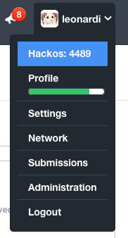
Workflow
Login to hackerrank.com
Goto “Administration” Menu
Goto “Manage Challenges” Tab
Click ”Create Challenge”
Fill all the forms (todo: step by steps)
Inform SIG-Algorithm member for evaluation :
leonardi.l
calvin.w
k.winata
(to be updated)

Slide 7
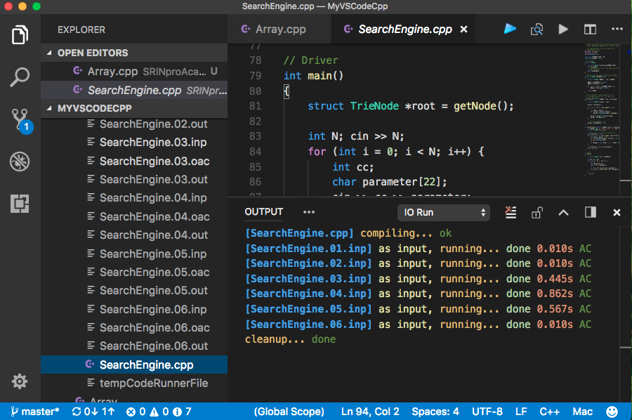
Tips
Use VS Code + IORun extension to ease test-cases generation

Slide 8
Example : Search Engine Simulation
Create a Search Engine Crawler! Where one thread of the engine crawl for new strings discoveries, another thread is standing by for search query.
This core of this search engine must be able to do these two query :
add "string" : store the string as a [data] to the engine data corpus ([database])
find "prefix" : the engine must return the number of matching data with this prefix in the database
You have to create an engine thats able to process a sequential queries and respond properly without fail!

Slide 9
Example : Search Engine Simulation
Input :
If the preceding int is 0 then the query is add "string"
If the preceding int is 1 then the query is find "string”
1 <= N <= 10^5
1 <= |string| <= 21
It is guaranteed that the "string" contains lowercase, one word, english letter only
It is guaranteed that there is no duplicate "string" for [add] queries
For each query, find out how many [data] in the current library that is starting with the [prefix] string

Slide 10
Example : Search Engine Simulation
Output Format
For each find query, find out how many [data] in the current library that is starting with the [prefix] string
Sample Input 0
7
0 search
0 engine
1 sea
1 eng
0 library
0 liberated
1 lib
Sample Output 0
1
1
2

Slide 11
Complexity Analysis
Brute Force
Store all “string” in an array
Iterate 1 by 1 to find matching “prefix”
Insert = O(1)
Search = O(n)
Total~ = n * (1 + n) = n^2 = 10¹⁰
Trie
Create a Trie to store all “string”
Iterate a path to find matching “prefix”
Then reccursively travel to each successor to count “data”
Insert = O(m)
Search = O(m * m)
Total = n * (m + m * m) = 10⁵ * 10² = 10⁷
n = query
m = str length

Slide 12
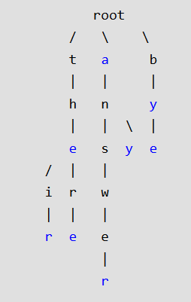
Tricks
No duplicate inputs?!
When creating Trie data structure, also count how many times a path is visited
This indicate how many child does a path has!
Suitable to answer the problem (prefix check)
Complexity :
Insert = O(m)
Search = O(1)
Total = n * (m + 1) = 10^5 * 10¹ = 10⁶

Slide 13
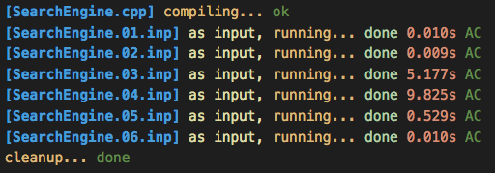
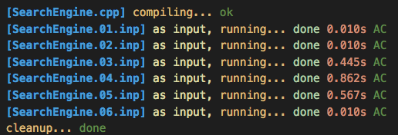
Robust Test Case
Then we could tighten the test case to make sure a 10^6 solution does not pass
10^7 solution
10^6 solution
This is what we expect you to explain on your dojo afterwards!

Slide 14
Final Notes
Be Immersive
By doing Problem Setter jobs, you’ll understand many of the hidden mechanics behind a competitive-programming problem.
For Greater Good
Improving one selves (as problem-setter) and many others (as problem-solver).
Be Experienced
Thus increasing our chances to go Pro/Expert level.

